Slide 1

Network Layer: Subnetting
Lecture 7 | CSE421 – Computer Networks
Department of Computer Science and Engineering School of Data & Science

Slide 2
Objectives
IPv4 Exhaustion
Solution to the depletion of IPv4
Types of Subnetting
Examples

Slide 3
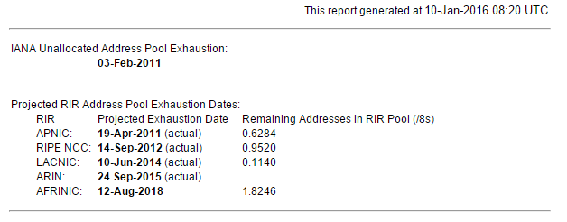
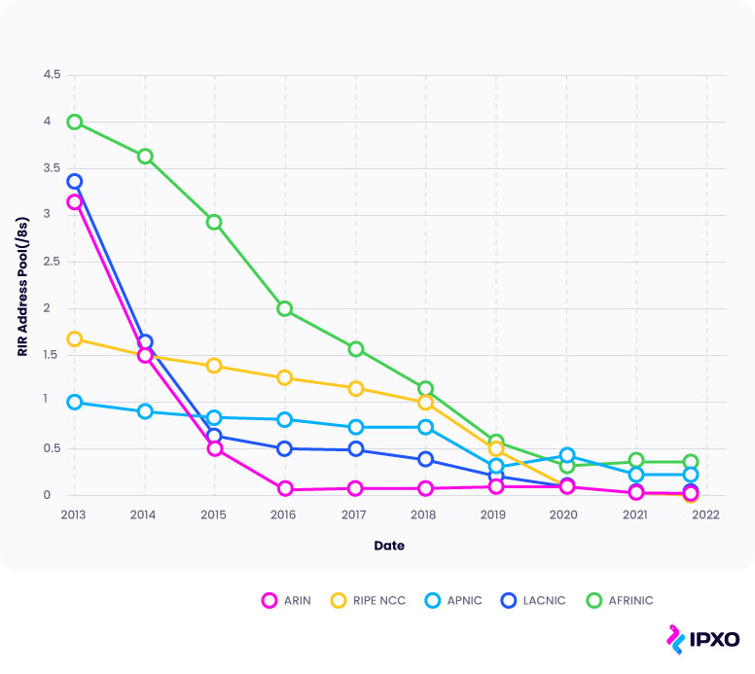

IPv4 Address Exhaustion

Slide 4
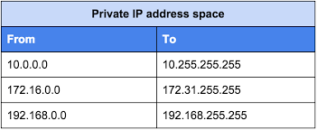
Solutions
Long term:
Change to IP version 6.
Plenty of addresses using a different scheme
Short term:
Use Subnetting to avoid wasting addresses
Use private addresses locally and NAT for internet access – lets many host share a few public addresses

Slide 5
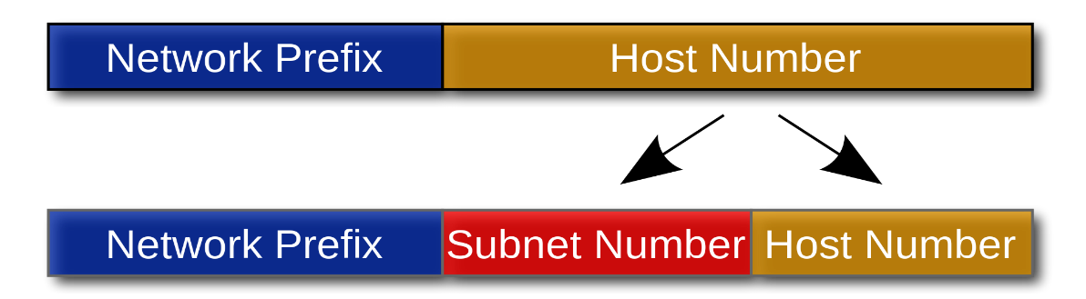
Subnetting
Partition a single physical network into more than one smaller logical sub-networks (subnets).
Borrow bits from the IP address's host part
Use these bits to create a number of smaller sub-networks inside the original network.
Notes:
Subnets are designed by accepting bits from the IP address's host part and using these bits to assign a number of smaller sub-networks inside the original network.
Allows an organization to add sub-networks without the need to acquire a new network number via the Internet service provider (ISP).

Slide 6
Subnetting
Two methods of subnetting
Fixed Length Subnet Masking
Variable Length Masking

Slide 7
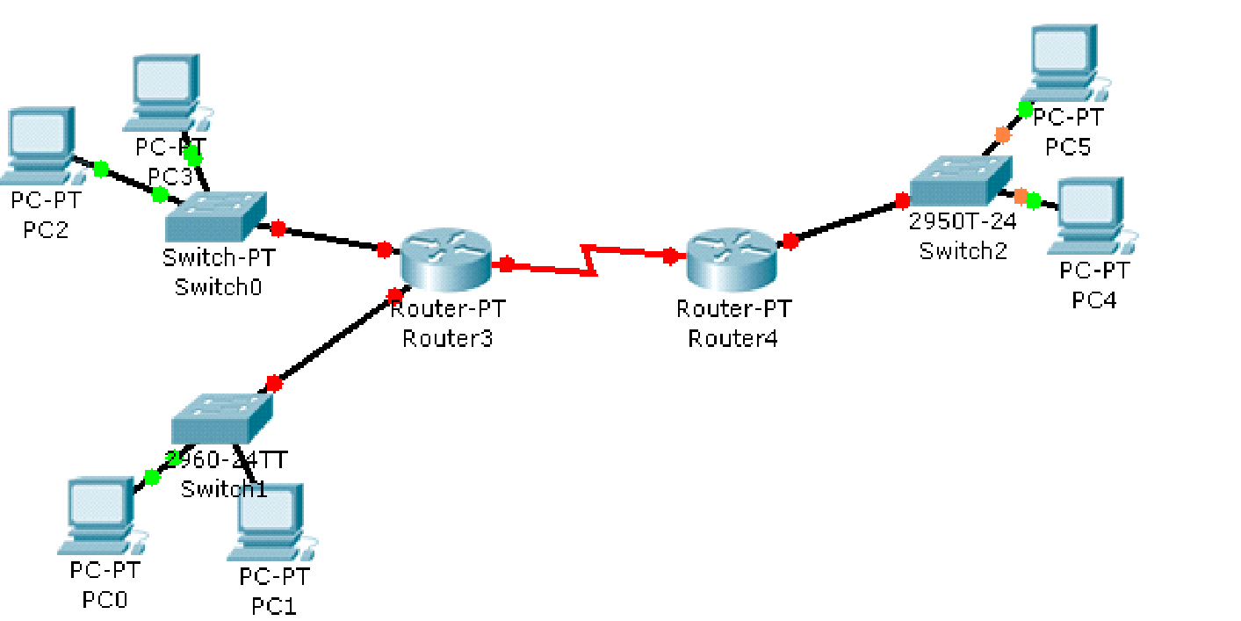
Fixed length subnetting
How many network addresses do you need for the organization?
How many network addresses do you have?
How many bits do you have for hosts?
How many host bits do you need to borrow to create the number of sub networks that you need?
1
200.20.20.0/24
8 bits
2 bits
1
3
Banani Branch
10 Hosts
4
2
Khulna Branch
60 Hosts
Motijheel Branch
40 Hosts

Slide 8
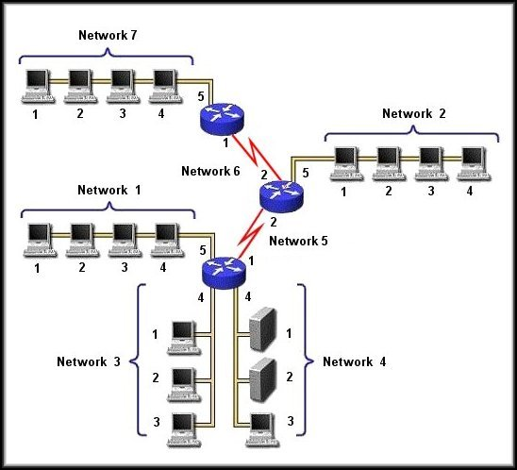
Fixed Length Subnetting: Example
192.168.80.192/27
192.168.80.0/24
192.168.80.32/27
192.168.80.160/27
192.168.80.0/27
192.168.80.128/27
192.168.80.64/27
192.168.80.96/27

Slide 9
Lots of Waste!
Problem of Fixed Subnetting:
Waste IPv4 addresses.
For example : Router3 –Router2 Network requires 2 IP addresses.
How many is available? How many wasted?
62
60
200.20.20.192/26
If you are using private addresses, then you may not be bothered.
Waste of public addresses does matter.
Solutions:
Variable Length Subnet Masking (VLSM)
Create subnets as per specific host requirements.

Slide 10
VLSM
Also known as “Variable Length Subnet Masking”
Assign a block of IP satisfying only that particular LAN.
200 hosts? Assign a block of size 256 IPs!
1000 hosts? Assign a block of size 1024 IPs!
2 Hosts? Assign a block of size 2 IPs!
Always satisfy the requirements of your biggest LAN and then work your way down to the smallest LAN.

Slide 11
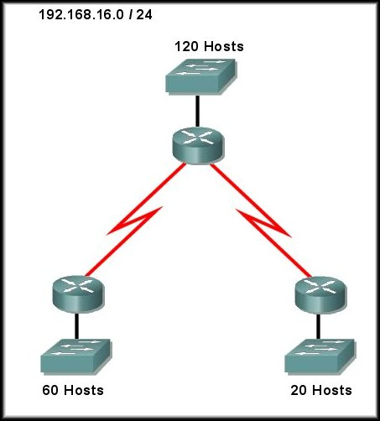
VLSM Example 1

Slide 12
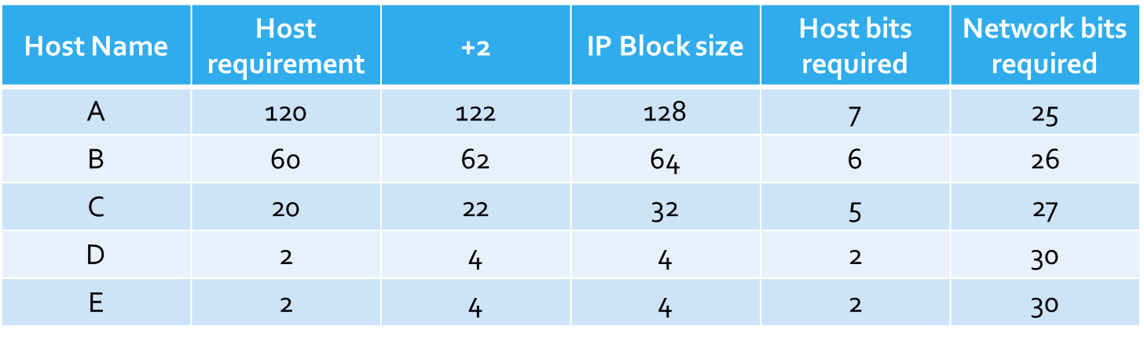
VLSM Example 1
Given network address
192.168.16.0/24
192.168.16.0/25
192.168.16.128/25
192.168.16.128/26
192.168.16.192/26
192.168.16.192/27
192.168.16.224/27
192.168.16.224/30
192.168.16.228/30

Slide 13
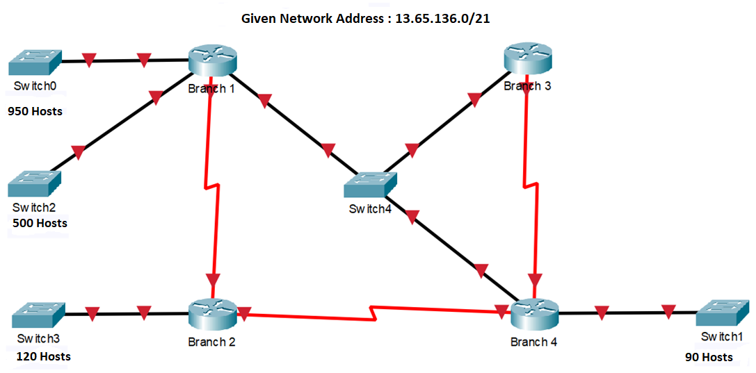
VLSM Example 2
4 LANs
3 WANs
1 Switched Network

Slide 14
VLSM Example 2

Slide 15
The End

